Slide 1
Balanced Feeding in European fishponds to make agri-food system transitions
Dr. Koushik Roy, Ph.D.
Assistant Professor and deputy lab head
Laboratory of Nutrition and CENAKVA RP3

Slide 2
Let’s begin with a reality check of Czech blue food system!
Dimension | Ambition | Reality-check
Per capita fish consumption | 2 portions week⁻¹ (200 g portion⁻¹); 19-20 kg capita⁻¹ year⁻¹ | <1 portion week⁻¹; 6–8 kg capita annum
Annual per capita freshwater fish production | No ambition | 2 kg capita⁻¹ year⁻¹
Imported marine fish to local freshwater fish | No ambition (ideally, 1:1) | 2.75: 1
Meat and fish balance in planetary healthy diet | 1:1 (chicken: fish); 0.5:1 (red meat: fish) | 5:1 (chicken: fish); 9:1 (red meat: fish)
Minimum per capita EPA+DHA intake | 250 mg EPA+DHA day⁻¹ | 218 mg EPA+DHA day⁻¹
Omega-3 index of adult human population | >8% | 2.5-3.5%
Dear FAO – you are here every year. Please stimulate “blue transformation” vision projects in Czechia.

Slide 3
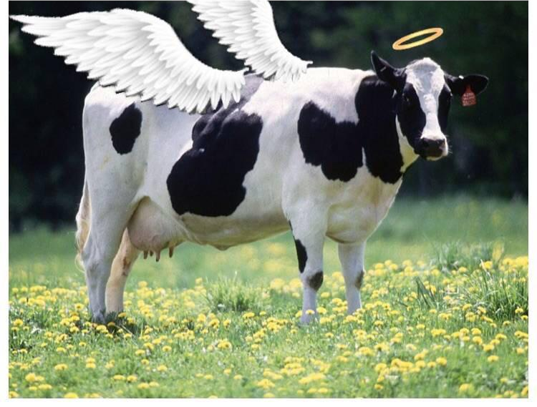
Services beyond just fish, called ecosystem services.
Can eat grass (fibres, agri-food by-products) and produce food (fish).
For ponds, fish is only an organ among many.
Contain enzymes, microbiota, and natural food web (plankton, benthos) as other organs.
The organ system produces food (fish flesh) as we know it.
Balanced pond feeding= We do not feed one organ, but the whole system!
Ponds - the holy cow of aquaculture!!

Slide 4
Eat a pond carp= environmentally sustainable food choice!
Pond carp= Nitrogen and phosphorus use efficiency close to chicken!
Nutrients digestibility in pond fish > Nutrient digestibility in RAS fish.
CEER carp ponds consume 0.3 million tons of cereals per year! – Feed-food conflict? Land use?

Slide 5
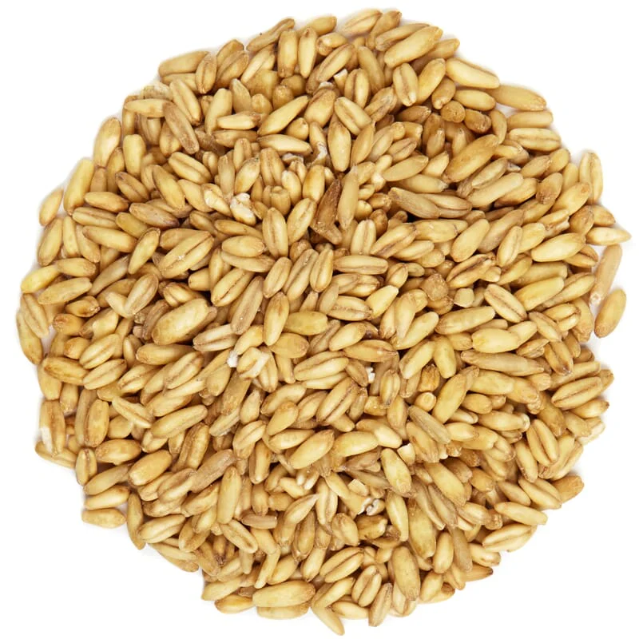
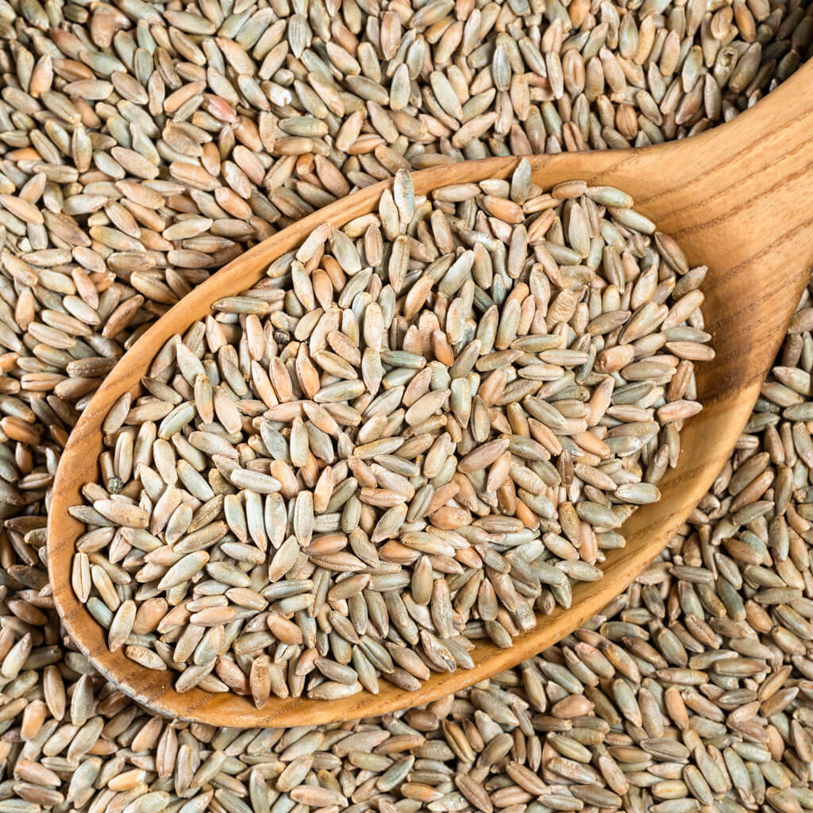
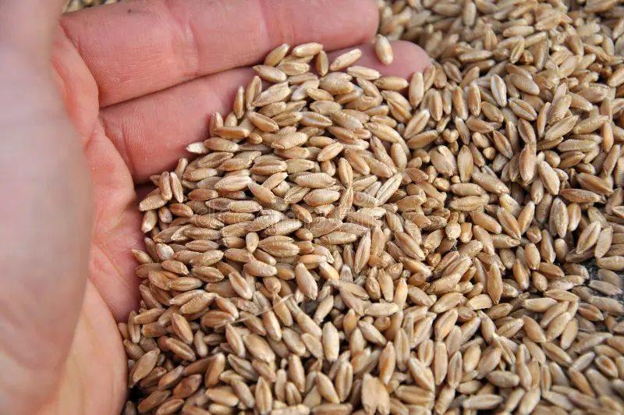
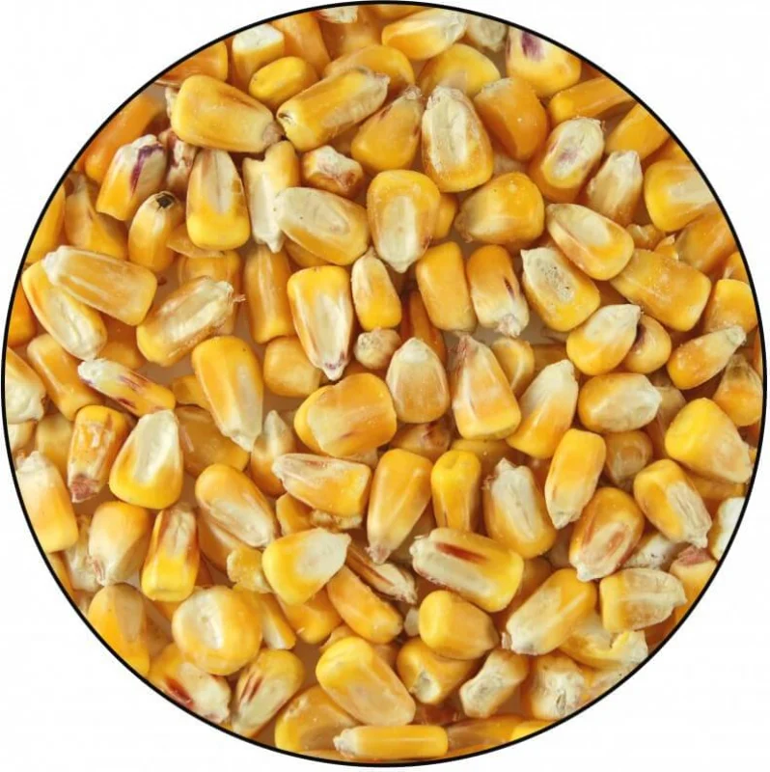
Historical standards – European fishponds (grain fed)
Wheat/ Rye/ Triticale/ Corn
Protein 10-15% (!)
290-300 kcal DE/ 100 g
Working since 162+ years.
Fullner 2015
Woynarovich 2010

Slide 6
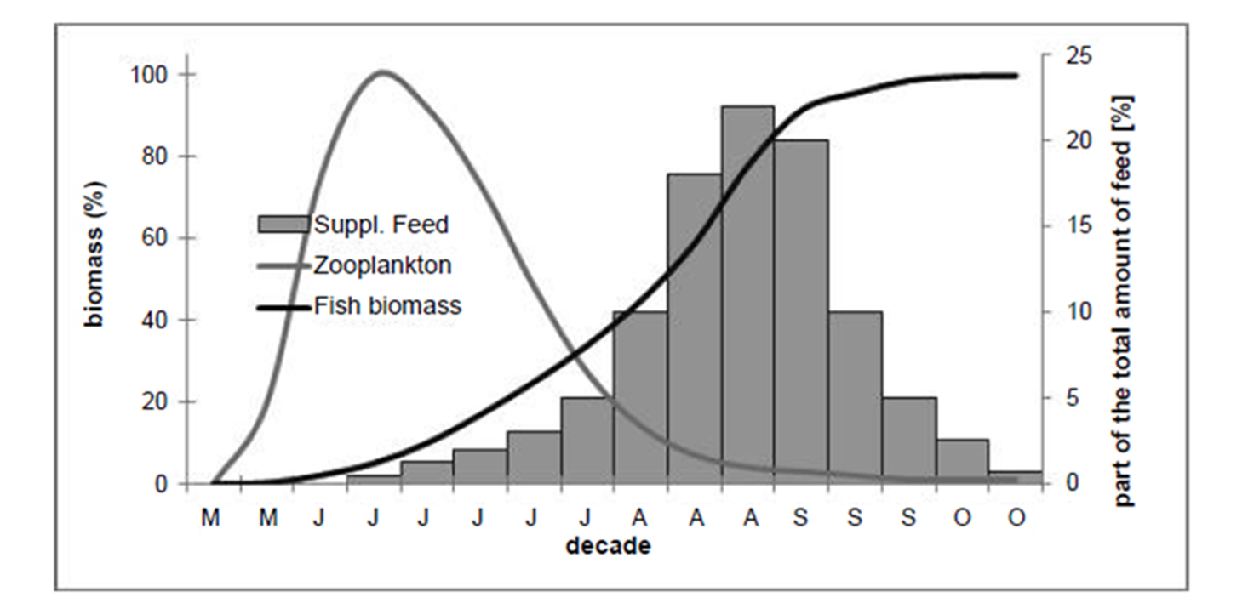
Traditional pond feeding
Supplement carbohydrate energy (mostly starch) and phytate-P
300-350 kg/ ha stocked
1 ton/ ha realized
April to October
2.5-3.5 kg cereal fed/ kg yield
Fed from June/July

Slide 7
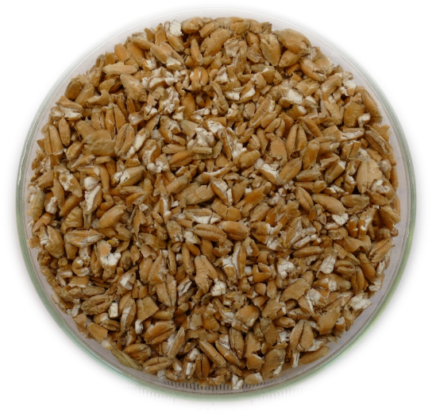
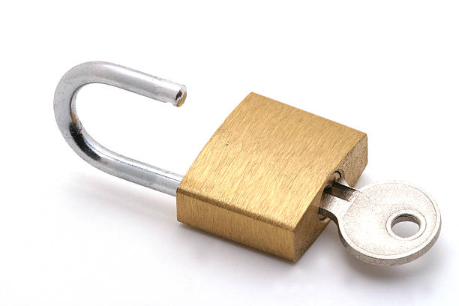
How cereal feeding works in pond? – Like Lock and key
Excess bioavailable phosphorus = Bad
Lysine – Methionine High = Good
Non-protein energy low = Bad
Bioavailable phosphorus low = Good
Lysine – Methionine is low = Bad
Non-protein energy high = Good

Slide 8
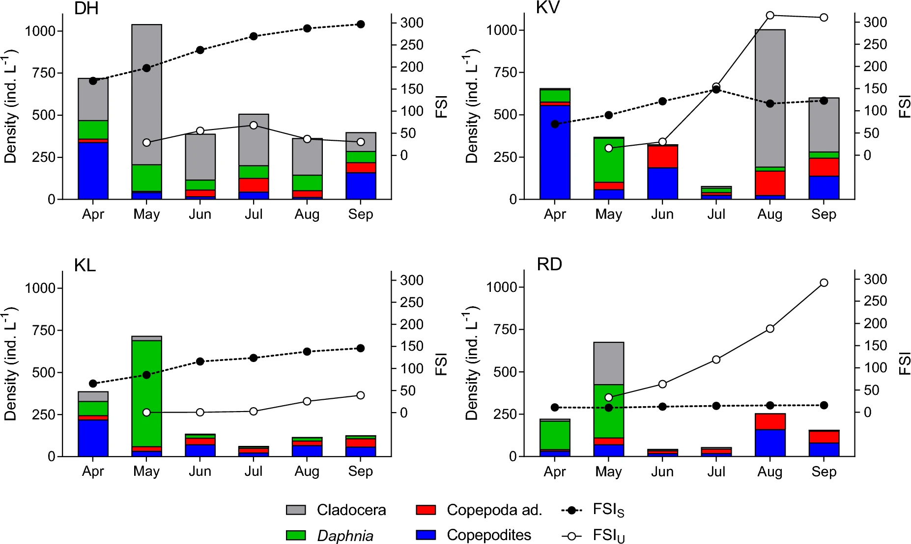
But key can be lost: natural food collapse

Slide 9
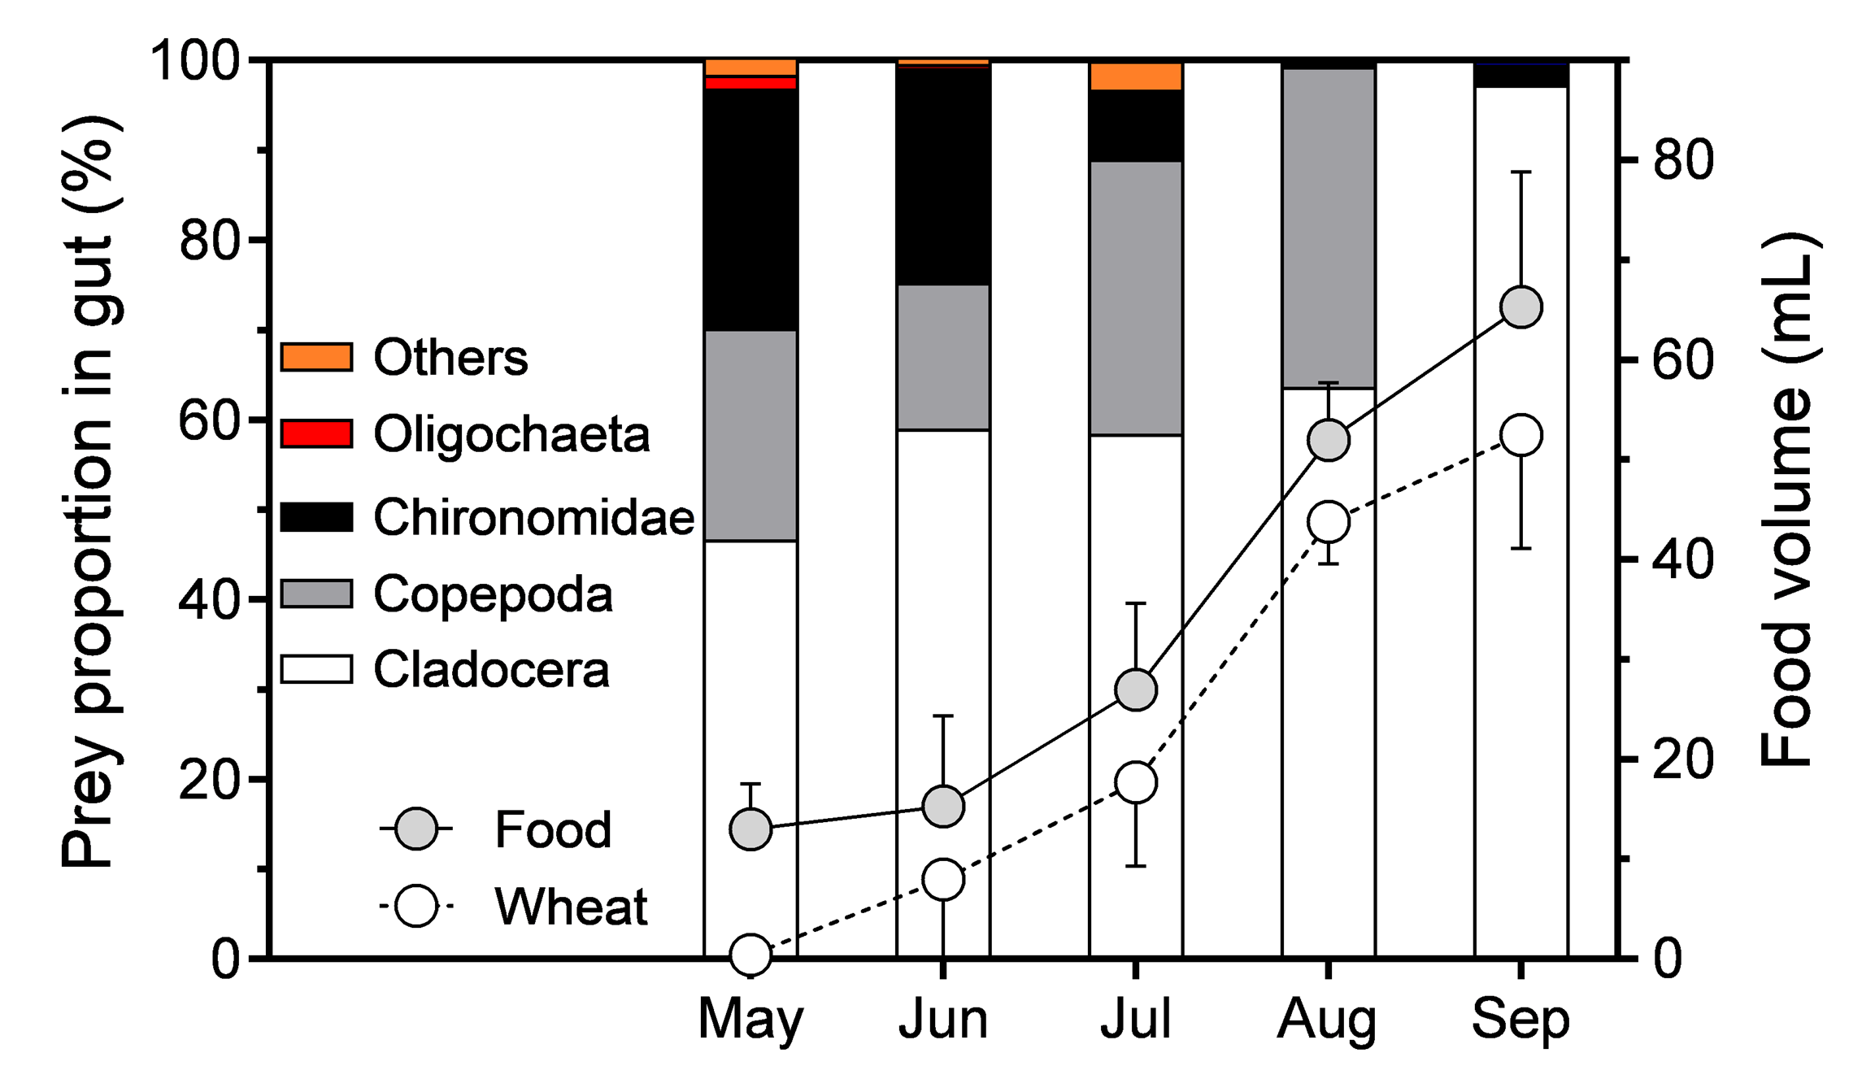
The key being lost: fish gut contents
Poor accretion
Nutrients wastage

Slide 10
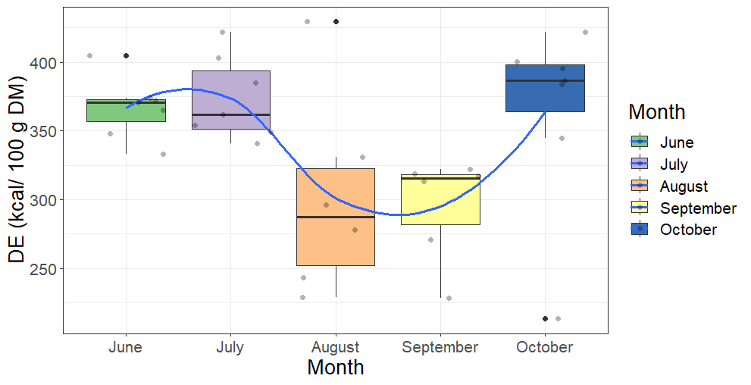
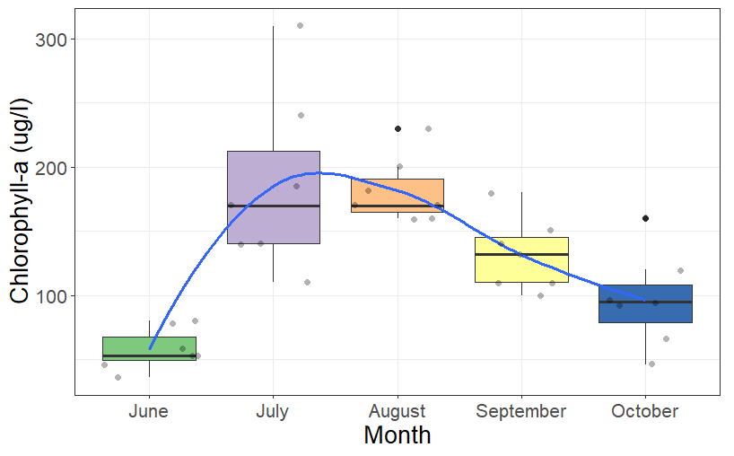
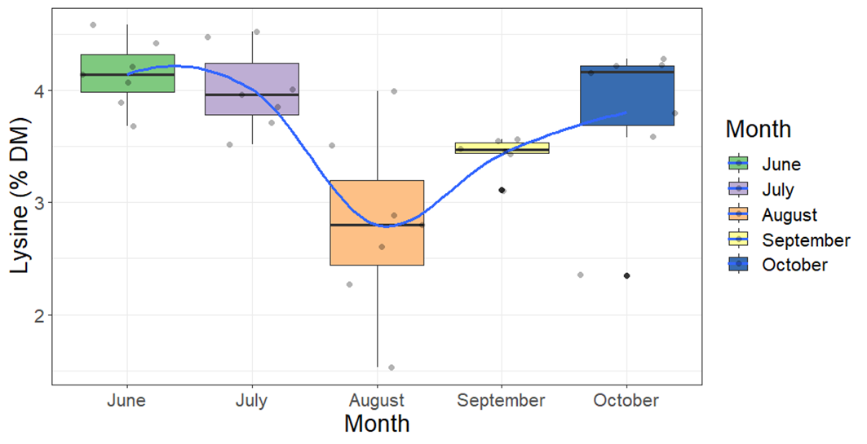
Key can be present but broken: natural food nutrition

Slide 11
How we look at it?
Carps start on a “ketogenic-like” diet
..have a balanced diet in between – shortly ☹
And ends up with a starchy pudding!

Slide 12
Balanced pond feeding concept
Supply balanced amino acids (protein), non-protein energy (starch + lipid), and fermentable fibers here.
Supplement carbohydrate energy (starch) and fibers here with low phosphorus.

Slide 13
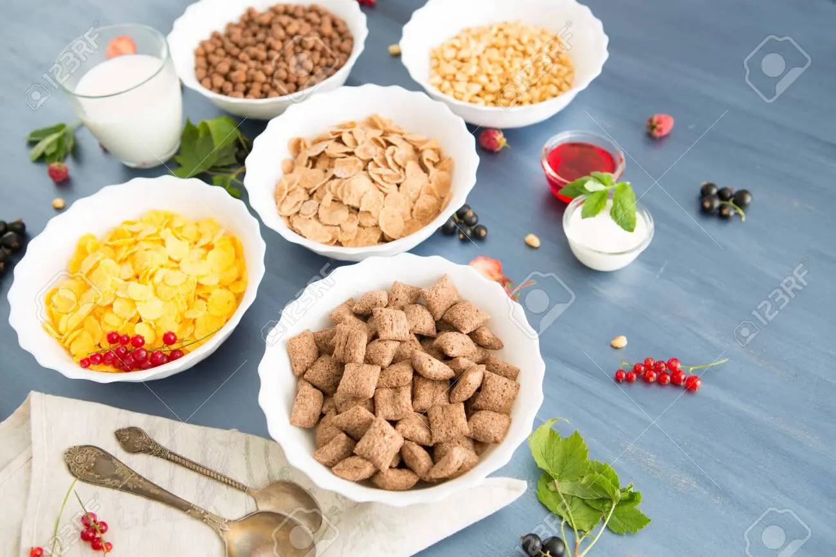
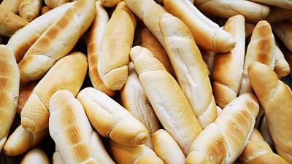
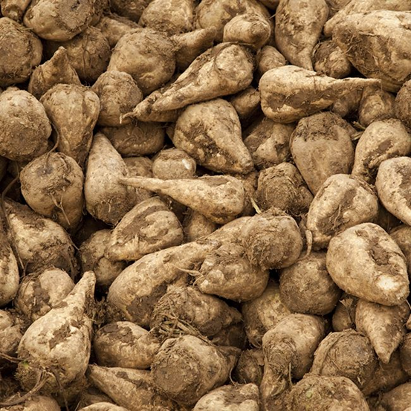
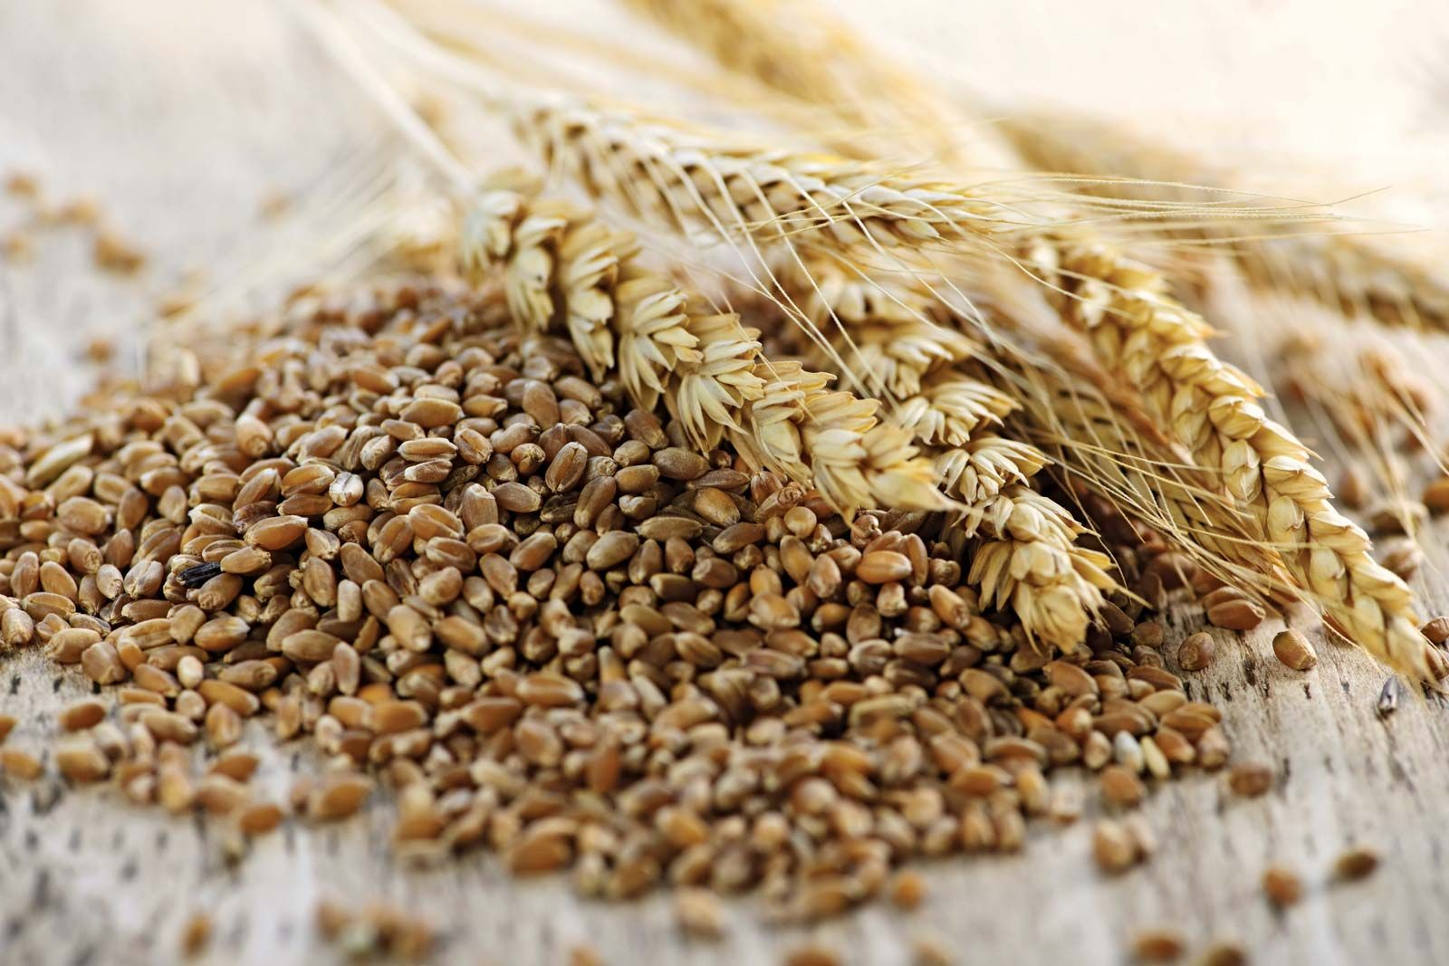
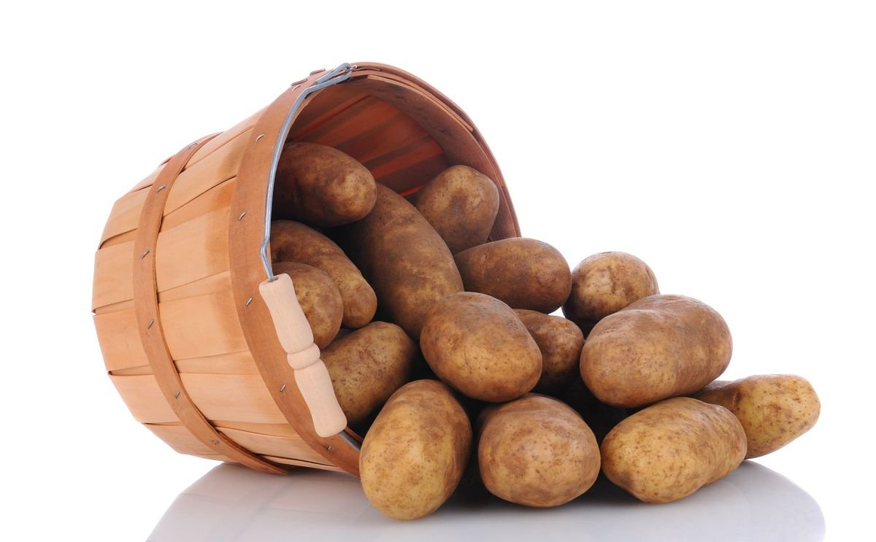
BEGINNING OF SEASON CARBOHYDRATE DOMINANTED STARCHY (>50%) VERY LOW PROTEIN (12%) “ENERGY” FEED (APR-JUN)

Slide 14
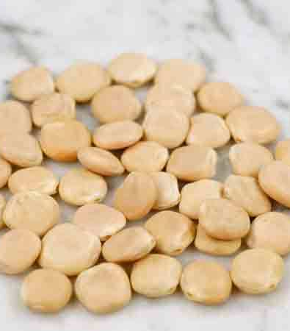
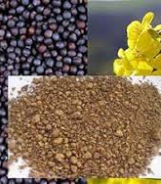
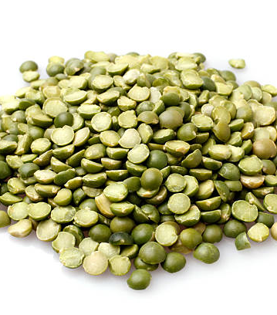
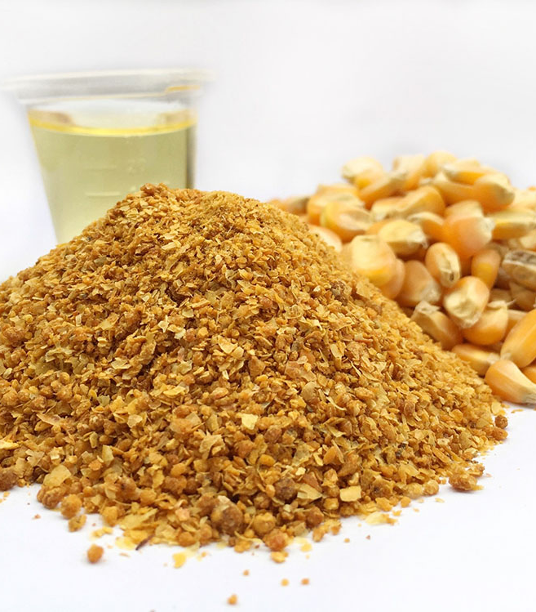
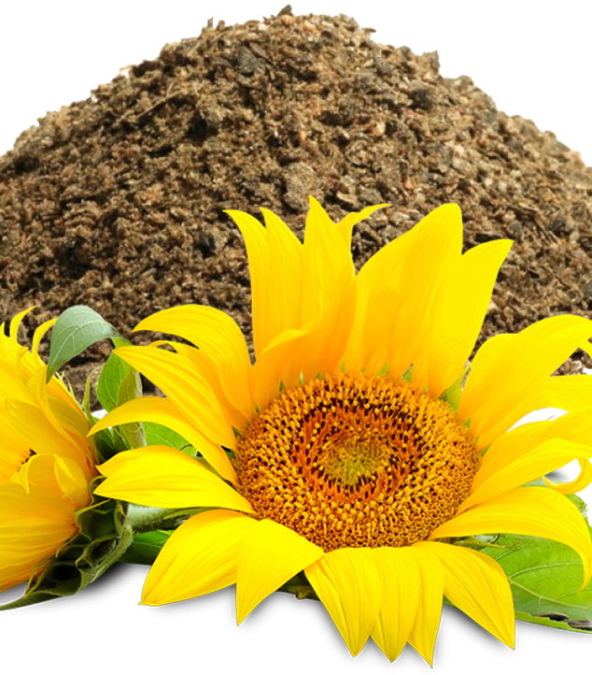
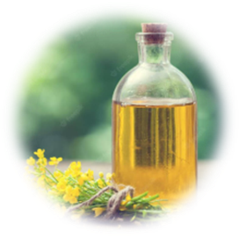
END-OF-SEASON LOW-PROTEIN (25%), Lys-Met BALANCED PRECURSORS RICH (pond Carbon & fish ALA) ENERGY BALANCED FEED (JUL-SEP)

Slide 15
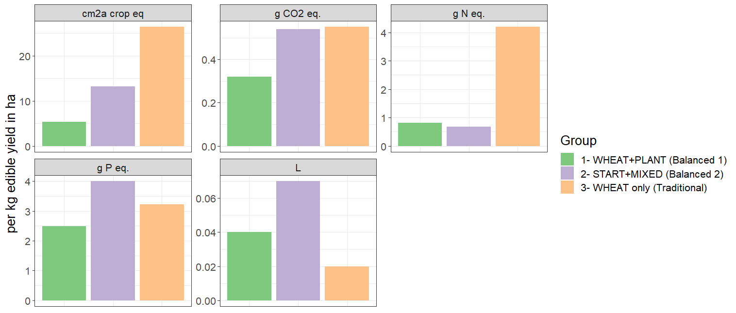
SUCCESS STORIES
Land use
Climate change
N flow
P flow
Freshwater use
Balanced pond feeding efficacy
Survivability: 87% (-6%)
1.8 kg FBW (+50%)
1.5 ton/ ha; (+50%)
FCR 1.8 (-30%)
Edible yield 45% (+15%)

Slide 16
WATER FRAMEWORK DIRECTIVE
End-of-culture P level in pond water - similar
P resource use efficiency in ponds - maintained
Fed 1.85 kg P/ pond
Fed 5.53 kg P/ pond

Slide 17
NON-COLLAPSED FOOD WEB
Keystone species collapsed in traditionally fed ponds; unlike balanced fed ponds

Slide 18
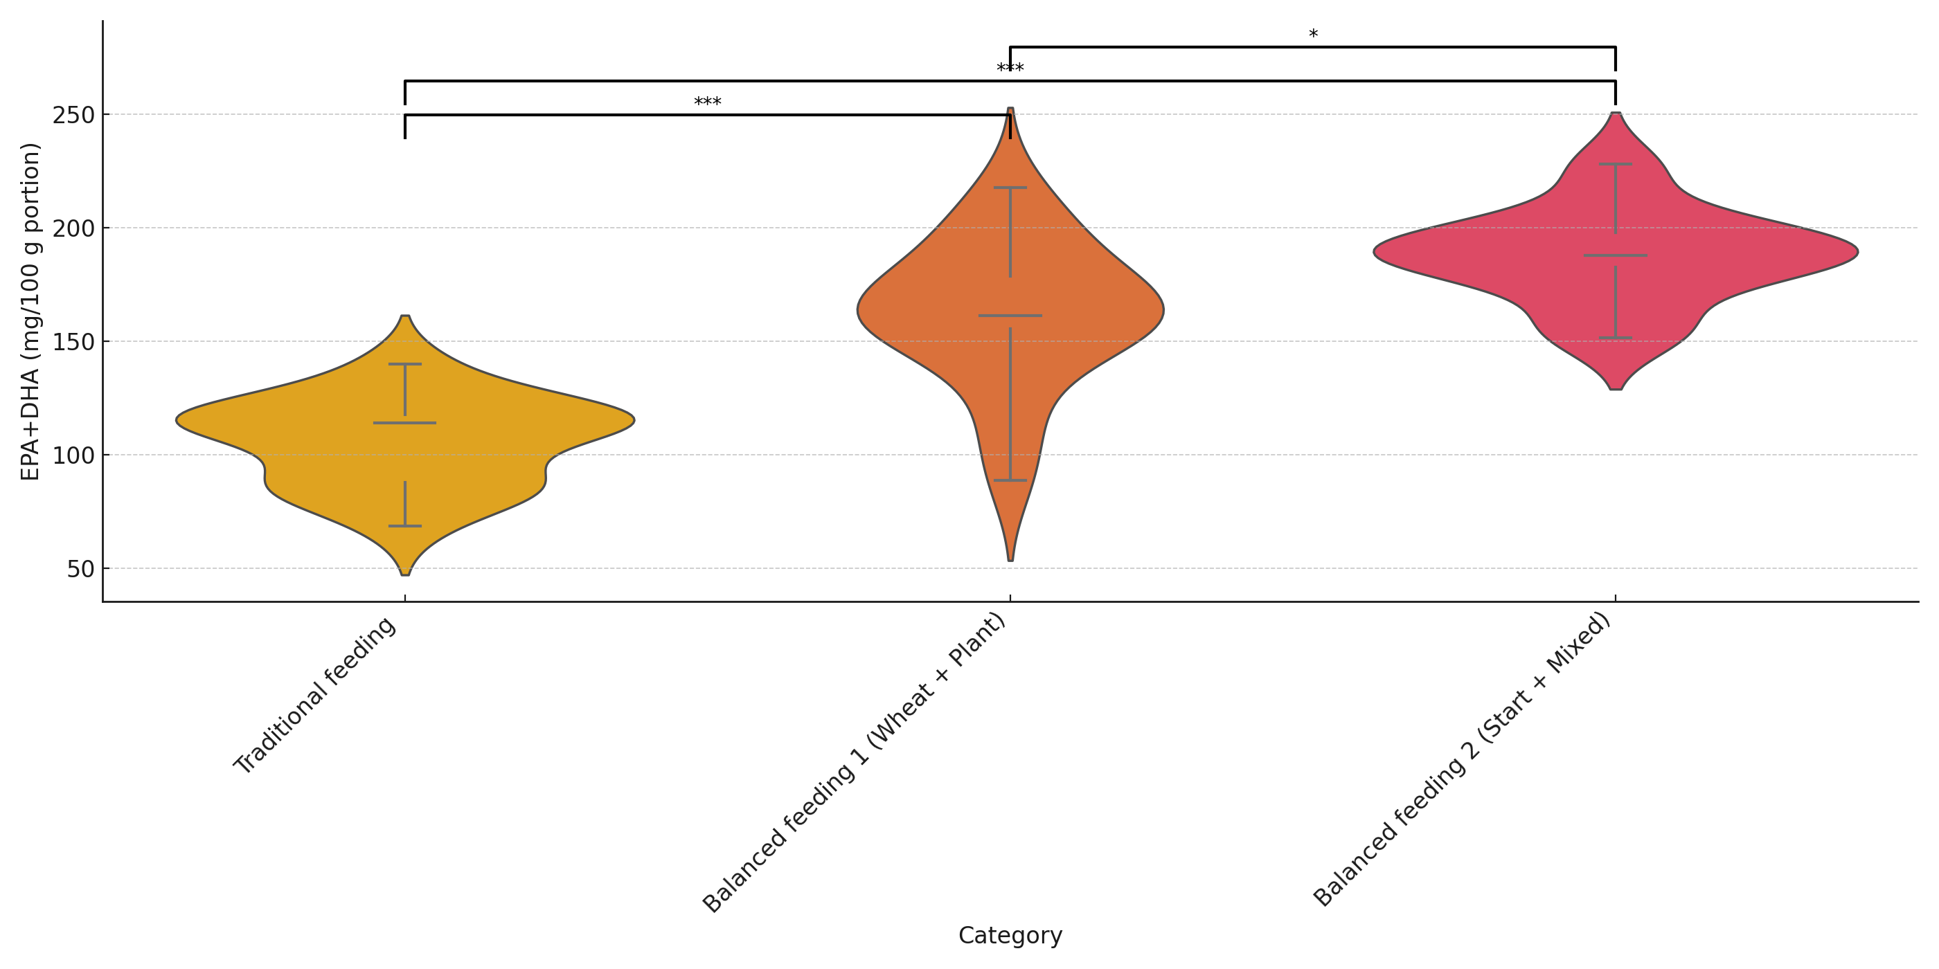
NUTRITIOUS FILLETS

Slide 19
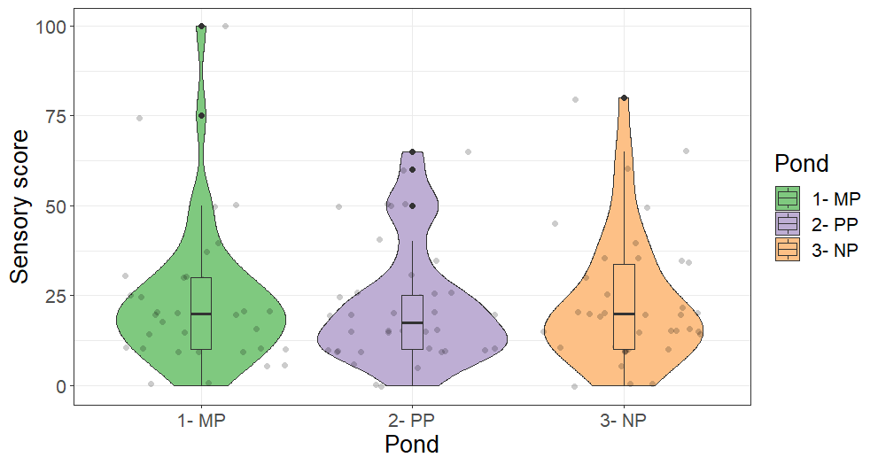
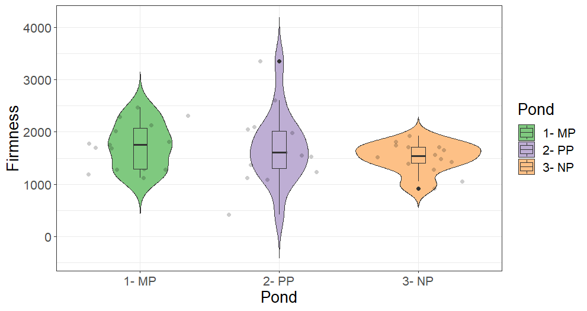
Sensory product quality at Fork
Bad
Good
Machine measurement
Measured by people

Slide 20
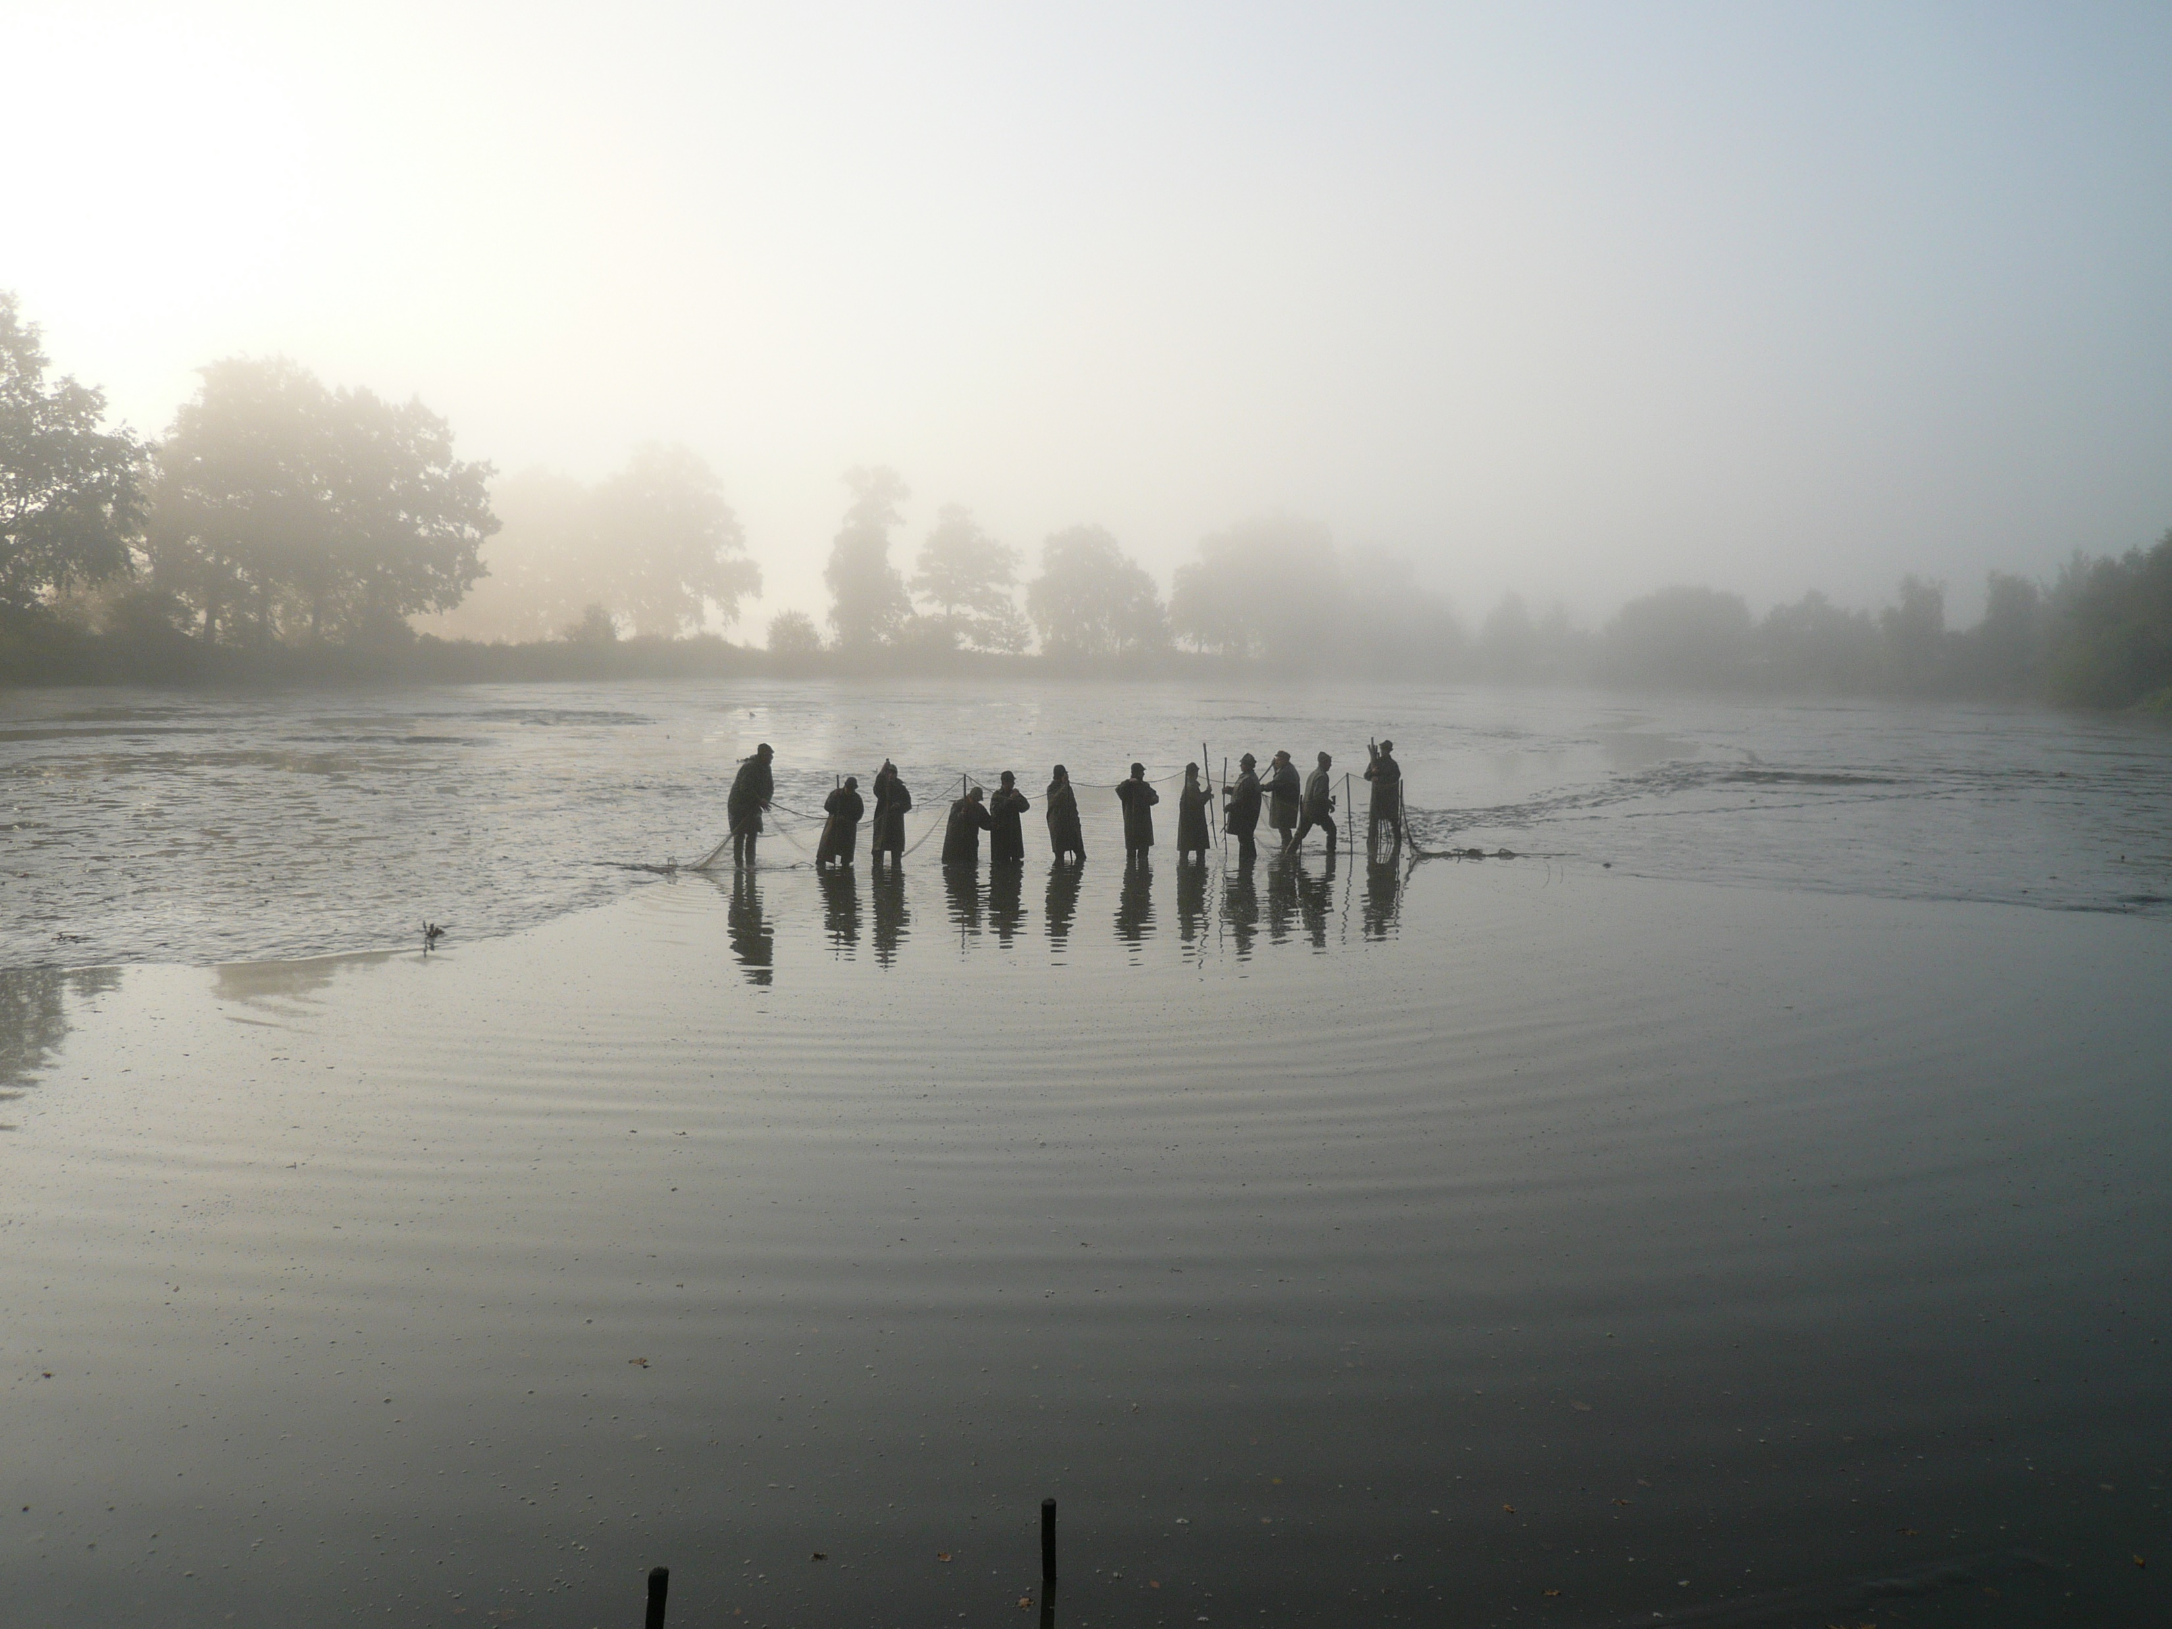
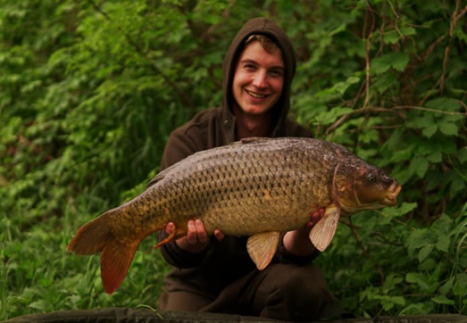
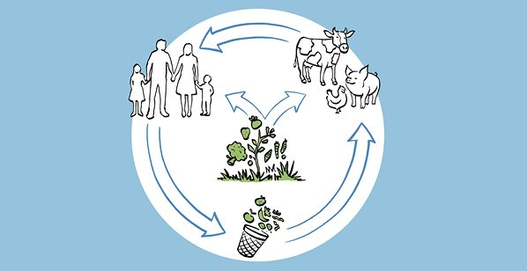
CEER carp ponds consume 0.3 million tons of cereals per year! – causing feed-food conflict, and occupying land for their agriculture

Slide 21
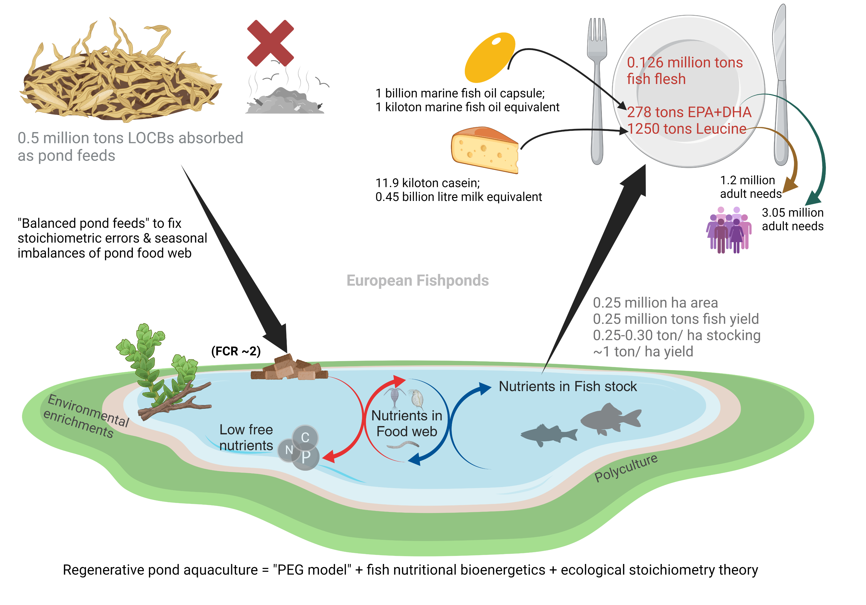
Less-refined & Balanced pond feeds made of local agri-food by-products can change that!

Slide 22
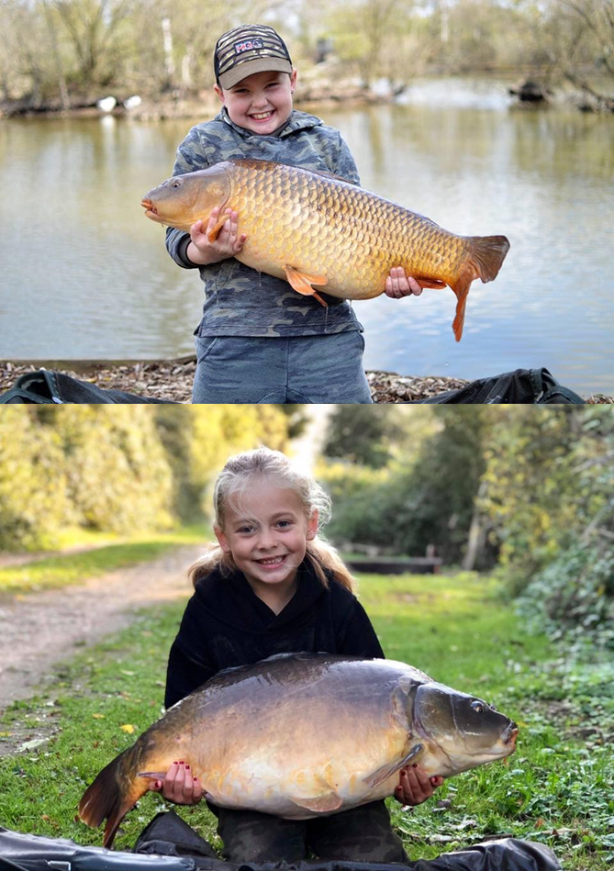
Take home message with numbers
Ponds are not old school. It is sexy!
Farming with a touch of ecology + nutrition.
Our technology can be game changing for EU!
Pond aquaculture – a sleeping giant within EU food system!
0.25 million ha available CEER fishponds.
0.5 million tons agri-food by-products can be absorbed/ year.
278 tons EPA+DHA & 1250 tons Leucine generated/ year.
Equivalent to 1 billion marine fish oil capsules & 0.45 billion litres of milk/ year.
Equivalent to 1-3 million adults need for Leucine & EPA+DHA/ year.

